Slide 1
GROUP - 19
GROUP MEMBERS : -
22MIP10067 – ARYAN SHRIVASTAVA
22BCY10294 – SANJANA LANKA
22BCG10153 – EISHITA PARIK
22BCG10178 – RAKESH SUTHAR
22BCG10162 – RAMAN KUMAR
SUB CODE & NAME :– CSE3006 (COMPUTER NETWORKS)
TOPIC :- CONGESTION CONTROL TECHNIQUES – CONGESTION PREVENTION POLICIES

Slide 2
INTRODUCTION (What is Congestion in Networking?)
Congestion occurs when the volume of data traffic in a network exceeds its capacity to handle it efficiently.
This leads to performance issues such as:
(i) Increased Delays: Packets take longer to reach their destination.
(ii) Packet Loss: Data packets are dropped when buffer limits are exceeded.
(iii) Reduced Throughput: Network performance degrades, causing slower data transmission.

Slide 3
INTRODUCTION (Importance of Congestion Control in Network Performance)
Enhances Efficiency: Ensures that all available network resources are utilized optimally.
Reduces Packet Loss: Prevents unnecessary retransmissions, saving bandwidth.
Improves Quality of Service (QoS): Delivers better user experience for real-time applications (e.g., video streaming, VoIP).
Prevents Network Collapse: Controls traffic to avoid complete network failure during high-demand periods.

Slide 4
OVERVIEW OF CONGESTION CONTROL
What is Congestion Control?
Congestion control refers to mechanisms and techniques used to manage or prevent network congestion.
It ensures optimal performance, avoids delays, and maintains data flow efficiency.
Types of Congestion Control Techniques
1. Reactive Techniques
Respond to congestion after it occurs.
Adjusts traffic flow dynamically to reduce congestion.
Example:
TCP Adjustments: Uses congestion window (cwnd) to regulate data flow based on network feedback.
Key Features:
(i) Detects congestion using indicators like packet loss or increased latency.
(ii) Adapts transmission rate accordingly.

Slide 5
OVERVIEW OF CONGESTION CONTROL (CNTD)
2. Preventive Techniques : Aims to avoid congestion before it happens.
Proactively manage network resources and traffic.
Example:
Traffic Shaping: Regulates the flow of packets to prevent sudden bursts.
Key Features:
(i) Focuses on pre-emptive measures.
(ii) Implements policies like admission control, resource reservation, and packet scheduling.

Slide 6
OBJECTIVES OF CONGESTION PREVENTION POLICIES
1. Minimize Packet Loss
Prevent data packets from being dropped due to overloaded buffers or queues.
Ensures reliable communication and reduces the need for retransmissions.
2. Optimize Bandwidth Utilization
Efficiently allocate available bandwidth to maximize throughput.
Avoid bottlenecks and ensure fair resource distribution among users and applications.
3. Reduce Delays and Jitter
Delays: Keep end-to-end transmission times low for better application responsiveness.
Jitter: Stabilize variations in packet delivery time to support real-time services like video conferencing and VoIP.

Slide 7
KEY CONGESTION PREVENTION POLICIES
1. Traffic Shaping
What it Does: Regulates the flow of outgoing data to prevent bursts and ensure a steady traffic rate.
Techniques:
(i) Token Bucket: Allows for bursts but maintains overall flow within a set rate.
(ii) Leaky Bucket: Enforces a fixed output rate regardless of incoming bursts.
Outcome: Smooths out traffic spikes and avoids sudden congestion.
2. Admission Control
What it Does: Monitors and controls new traffic requests based on the current capacity of the network.
How it Works:
(i) Rejects connections or reduces traffic if the network is nearing capacity.
(ii) Prioritizes critical data streams.
Outcome: Ensures the network doesn’t become overloaded.

Slide 8
KEY CONGESTION PREVENTION POLICIES (CNTD)
3. Resource Reservation Protocol (RSVP)
What it Does: Reserves bandwidth for high-priority or time-sensitive applications (e.g., video conferencing, VoIP).
How it Works:
(i) Allocates resources based on application demands.
(ii) Supports Quality of Service (QoS).
Outcome: Guarantees smooth operation for critical services.
4. Load Balancing
What it Does: Distributes data traffic evenly across multiple paths or servers.
Techniques:
(i) Equal-Cost Multi-Path (ECMP) routing.
(ii) Dynamic traffic reallocation based on real-time network conditions.
Outcome: Prevents bottlenecks and improves overall network efficiency.

Slide 9
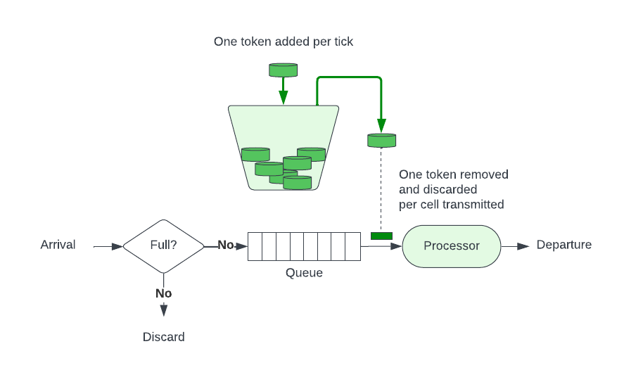
TRAFFIC SHAPING TECHNIQUES
1. Token Bucket
How It Works:
(i) Tokens are generated at a fixed rate and stored in a bucket.
(ii) Packets can be sent if enough tokens are available.
(iii) Allows short bursts of traffic if tokens have accumulated.
Key Feature:
Flexible and permits bursts without exceeding the average rate over time.
Use Case:
Ideal for applications requiring occasional high-speed transfers, such as file uploads.

Slide 10
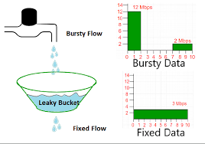
TRAFFIC SHAPING TECHNIQUES (CNTD)
2. Leaky Bucket
How It Works:
(i) Packets are added to a bucket (queue), which "leaks" at a constant rate.
(ii) If the bucket overflows, packets are dropped.
Key Feature:
Enforces a consistent output rate, regardless of bursty input.
Use Case:
Suitable for networks needing steady traffic flow, such as video streaming.

Slide 11
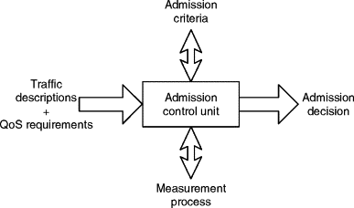
ADMISSION CONTROL
What is Admission Control?
Admission control is a proactive mechanism used by networks to regulate incoming traffic.
How Admission Control Works:
1. Traffic Assessment:
The network monitors its current load and available capacity.
2. Decision-Making:
If the network can handle additional traffic, the connection request is approved.
If not, the request is denied or delayed to prevent overload.
3. Resource Allocation:
Ensures that existing traffic flows are not disrupted by new connections.

Slide 12
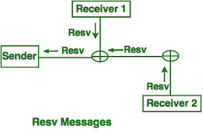
RESOURCE RESERVATION
What is RSVP (Resource Reservation Protocol)?
Definition: RSVP is a signaling protocol used to reserve resources across a network.
How It Works:
(i) Applications send resource reservation requests to routers along the data path.
(ii) Routers allocate bandwidth and prioritize the requested data flow.
(iii) Resources are maintained for the duration of the session.
Key Features:
(i) Works with IP networks.
(ii) Supports unicast and multicast communication.
(iii) Provides Quality of Service (QoS) for time-critical applications.

Slide 13
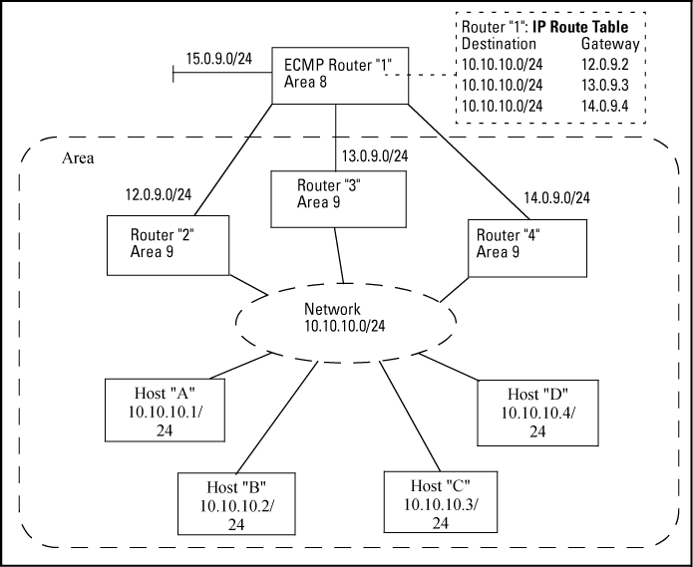
LOAD BALANCING
What is Load Balancing?
Load balancing is the process of distributing data traffic evenly across multiple servers or network paths to optimize resource utilization and avoid congestion.
How Load Balancing Works:
1. Traffic Distribution:
Incoming requests or data packets are analyzed and allocated to available resources (servers or paths) based on predefined algorithms.
2. Dynamic Adjustment:
Load balancers monitor network conditions and redistribute traffic if a server or path becomes overloaded or fails.
Key Protocol: ECMP (Equal-Cost Multi-Path)
What it Does:
ECMP enables traffic to be split across multiple paths with equal cost metrics in a routing table.
Advantages:
(i) Utilizes all available paths to balance traffic.
(ii) Reduces latency and prevents bottlenecks.
Example Use Case:
Data Centers using ECMP to route large volumes of web traffic efficiently.

Slide 14
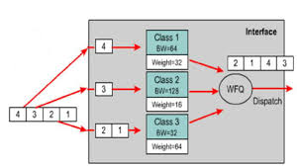
PACKET SCHEDULING
What is Packet Scheduling?
Packet scheduling refers to the process of determining the order in which data packets are transmitted over a network.
Key Scheduling Algorithms:
1. Fair Queuing (FQ):
Definition: Allocates an equal share of bandwidth to all active flows in the network.
How it Works:
(i) Packets are divided into queues based on their source or flow.
(ii) The scheduler alternates between queues to send packets in a round-robin fashion.

Slide 15
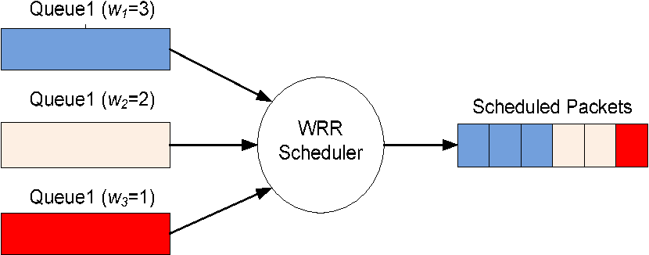
PACKET SCHEDULING (CNTD)
Key Scheduling Algorithms:
2. Weighted Round Robin (WRR):Definition: Allocates bandwidth based on predefined weights assigned to each queue.
How it Works:
(i) Packets are grouped into queues.
(ii) Each queue is assigned a weight, and the scheduler allocates resources proportionally.

Slide 16
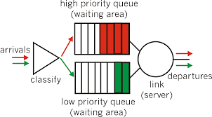
PACKET SCHEDULING (CNTD)
Key Scheduling Algorithms:
3. Priority Queuing (PQ):Definition: Processes packets based on their priority level, with the highest-priority packets being transmitted first.
How it Works:
(i) Packets are classified into priority levels (e.g., High, Medium, Low).
(ii) Higher-priority queues are always served before lower-priority queues.

Slide 17
BENEFITS OF CONGESTION PREVENTION POLICIES
1. Better Network Efficiency
Optimizes the utilization of network resources.
Prevents overloading of individual network components like routers or links.
Ensures smooth and consistent data flow across the network.
2. Reduced Latency and Packet Loss
Minimizes delays in data transmission, enabling real-time communication and applications.
Prevents packet drops caused by overflowing queues or excessive congestion.
Enhances reliability by reducing the need for retransmissions.
3. Improved Quality of Service (QoS) for Critical Applications
Guarantees bandwidth and low-latency connections for priority traffic, such as:
(i) Video streaming.
(ii) Voice over IP (VoIP).
(iii) Online gaming.
Enhances user experience by maintaining high performance for time-sensitive data.

Slide 18
CHALLENGES AND LIMITATIONS
1. Resource-Intensive Nature of Certain Techniques
Techniques like RSVP (Resource Reservation Protocol) require significant computational and memory resources.
Maintaining reserved bandwidth for priority applications can strain network capacity, especially in high-traffic environments.
Scalability becomes a challenge as the network size or user base grows.
2. Complexity in Implementation and Maintenance
Advanced policies like load balancing and packet scheduling require sophisticated algorithms and real-time monitoring.
Managing distributed systems (e.g., multiple load balancers or routers) adds complexity.
Frequent updates and fine-tuning are necessary to adapt to dynamic traffic patterns.
3. Trade-Offs Between Fairness and Efficiency
Fair Queuing ensures equal bandwidth allocation but might underutilize available resources if some queues are idle.
Priority Queuing improves performance for critical data but can lead to starvation of lower-priority traffic.
Balancing fairness (equitable resource allocation) and efficiency (maximum resource utilization) is a constant challenge.

Slide 19
CASE STUDY / REAL-WORLD EXAMPLE
1. ISP Bandwidth Management
Context:
Internet Service Providers (ISPs) often face congestion during peak hours when multiple users simultaneously access bandwidth-heavy services like video streaming and online gaming.
Solution: Congestion Prevention Policies
(i) Traffic Shaping:
ISPs use techniques like the Token Bucket to limit the bandwidth for certain non-critical services during peak times.
High-priority traffic, like VoIP or essential online services, gets preference.
(ii) Admission Control:
New bandwidth requests are assessed based on the current load, ensuring no additional traffic disrupts ongoing services.

Slide 20
CASE STUDY / REAL-WORLD EXAMPLE (CNTD)
2. Streaming Service Traffic Optimization
Context:
A global video streaming service (e.g., Netflix) must deliver high-quality video to millions of users simultaneously.
Solution: Congestion Prevention Policies
(i) Resource Reservation (RSVP):
Allocates bandwidth for video streaming sessions, especially in areas with high demand.
(ii) Adaptive Bitrate Streaming:
Dynamically adjusts video quality based on the user’s network conditions to prevent excessive buffering.

Slide 21
CONCLUSION
1. Summary of Key Points:
Understanding Congestion: Congestion occurs when network demand exceeds available capacity, leading to delays and packet loss.
Preventive Policies: Techniques like Traffic Shaping, Admission Control, Resource Reservation, Load Balancing, and Packet Scheduling play a vital role in avoiding congestion.
Benefits: Preventive policies improve network efficiency, reduce latency and packet loss, and enhance QoS for critical applications.\
2. Importance of Preventive Policies:
Preventive congestion control ensures seamless communication in modern networks, which is essential for:
(i) Real-time applications (e.g., VoIP, online gaming, telemedicine).
(ii) Business-critical services and data centers.
(iii) Everyday user experiences, such as streaming and browsing.
By proactively addressing congestion, networks remain reliable, efficient, and scalable even as demand grows.

Slide 22


